Slide 1




Market Price Prediction

Slide 2


OVERVIEW
01
02
03
04
Introduction
Visualization
Preprocessing
Feature Engineering
05
06
07
Feature Selection
Modeling
Acknowledgement

Slide 3



Introduction
In the realm of market analysis and forecasting, understanding complex patterns within time series data is crucial for making informed decisions. This project aims to develop a robust machine learning model to predict market trends based on historical monthly data, enabling stakeholders to make proactive decisions regarding production, procurement, pricing strategies, and resource allocation. By leveraging advanced algorithms, we strive to provide accurate forecasts for quantities and prices for upcoming months, enhancing efficiency and profitability within the market ecosystem.

Slide 4





OBJECTIVE
Develop Robust Time Series Model
Accurate Market Trend Predictions
Forecast Commodity Quantities and Prices
Empower Stakeholders' Decision-Making

Slide 5



IMPORTANCE OF PREDICTING
02
•Importance for Buyers:
•"For prospective homebuyers, accurate predictions can guide informed decisions, ensuring they make sound investments aligned with their financial capabilities and preferences.“
03
•Significance for Sellers:
"On the seller's end, predicting prices provides insights into market trends, enabling optimal pricing strategies for a competitive edge and maximizing returns."

Slide 6
Visualization
#
•Data visualization is the practice of translating information into a visual context, such as a map or graph, to make data easier for the human brain to understand and pull insights from.

Slide 7
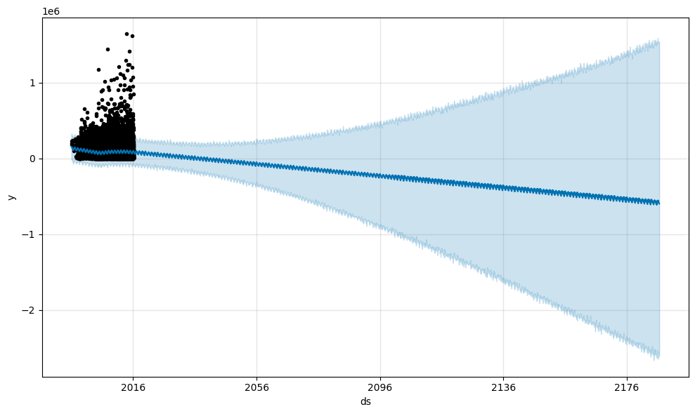
The Distribution of Our Target

Slide 8
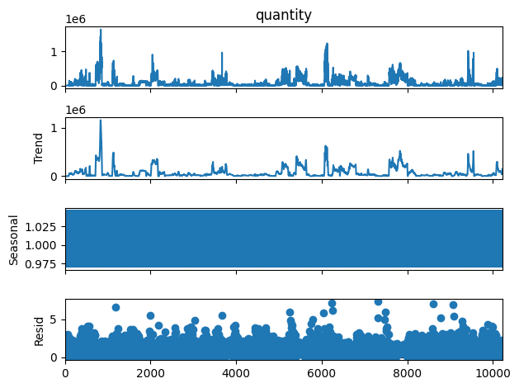
Distributions of Variables

Slide 9
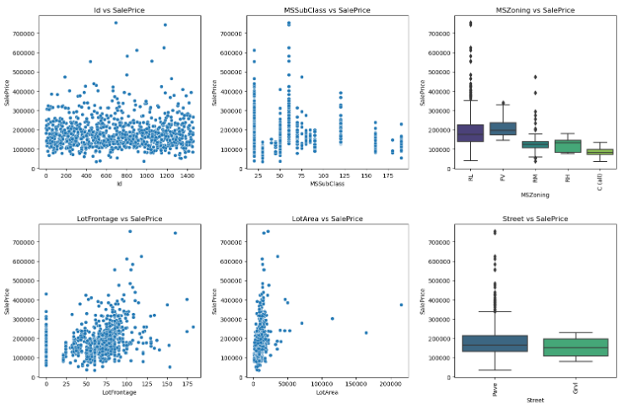
Relationship between Target and the Variables
Relationship between Target and the Variables

Slide 10
Data preprocessing
01
The technique of preparing (cleaning and organizing) the raw data to make it suitable for a building and training Machine Learning models.
First ,we searched about the duplicate rows in the data ,and we found 0 duplicate mean that the data don’t have any duplicate rows .
Secondly, we investigated the missing data to deal with it as required.

Slide 11
Modelling
In our pursuit of optimizing model performance, we systematically experimented with various scaling techniques. we explored different scaling approaches, including Min-Max Scaling, Standard Scaling, and Robust Scaling, to enhance the model's sensitivity to input variations.
Furthermore, we delved into dimensionality reduction experiences, employing techniques such as Principal Component Analysis (PCA), Linear Discriminant Analysis (LDA), and t-distributed Stochastic Neighbor Embedding (t-SNE). These reduction techniques are aimed at capturing essential information while mitigating the curse of dimensionality.

Slide 12
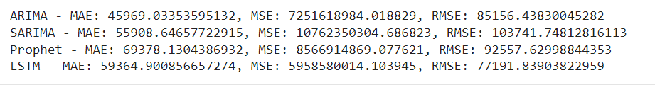
Modelling
The modelling process is where we breathe life into our data, employing advanced algorithms and machine-learning techniques to uncover patterns, relationships, and predictive trends. In this stage, we tried many regression models like:
ARIMA
SARIMA
Prophet
LSTM

Slide 13

Acknowledgement
In conclusion, we are thrilled to announce that our team has successfully achieved an impressive score
This accomplishment is a testament to our collective effort, dedication, and teamwork. Thank you all for your hard work and commitment to excellence.
We appreciate the company's commitment to promoting teamwork, as it not only benefits us as individuals but also contributes to the overall success and synergy of our project. Thank you for recognizing the value of collaboration and providing us with the platform to thrive as a team.

